Slide 1
System Design Basics
Topics: LB & DB sharding

Slide 2
Vertical Scaling vs Horizontal Scaling

Slide 3
LB Algorithms
1: Layman's Approach
2: Least Connections
3- Least Response Time
4- Round Robin
5- Weighted Round Robin
6: IP Hash
7: Consistent Hashing

Slide 4
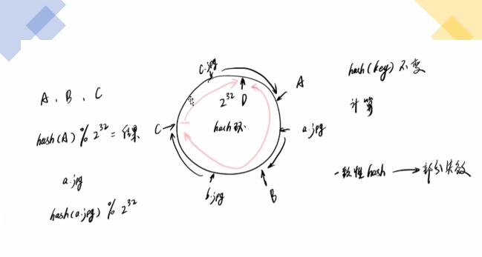
Consistent Hashing
Notes:
Problem: The real data is randomly distributed and thus may not be uniform. The keys on caches may be unbalanced.
Solution: Add “virtual replicas” for caches. We map each cache to multiple points on the ring. Each cache is associated with multiple portions of the ring.

Slide 5
Notes:
Instead of assigning a single token to a node, the hash range is divided into multiple smaller ranges, and each physical node is assigned several of these smaller ranges. Each of these subranges is considered a Vnode. With Vnodes, instead of a node being responsible for just one token, it is responsible for many tokens (or subranges).

Slide 7
Scaling Database
Step 1: Query Optimization & Connection Pool implementation: Includes denormalization and Indexing
Step 2: Vertical Scaling or Scale-Up
Step 3: Command Query Responsibility Segregation: primary-replica
Step 4: Multi Primary Replication A->B->C->-A
Step 5: Partitioning (by functionality) 分区 grouping within db
Step 6: Horizontal Scaling
Step 7: Data Centre Wise Partition: different geo locations
Notes:
Problem with vertical scaling: database index size is increasing heavily in memory
Step 3: read write separation: 2 replica for read; problem: inconsistent, delayed read
Step 4:a circle: write to any node; read: broadcast the query to all nodes whoever replies
Step 5: location db: high traffic; put on a separate machines
Step 6: store all related data in the same machine; sharding key

Slide 8
Sharding = data partitioning
Horizontal or Range Based Sharding
Vertical Sharding
Key or hash-based sharding
Directory based sharding

Slide 9
Horizontal or Range Based Sharding
Notes:
Last name A-H on one shard
Not evenly distributed

Slide 10
Vertical Sharding
Notes:
Pros: handle critical data differently
Cons: combine data later

Slide 11
Key or hash-based sharding
Notes:
Key: IP address
Problem: dynamically adding/removing database servers becomes difficult
Solution: consistent hashing

Slide 12
Directory based sharding
Notes:
Look up service

Slide 13
Reference
https://www.freecodecamp.org/news/understanding-database-scaling-patterns/
https://www.acodersjourney.com/database-sharding/
https://medium.com/codex/how-to-use-consistent-hashing-in-a-system-design-interview-b738be3a1ae3c

